Slide 1
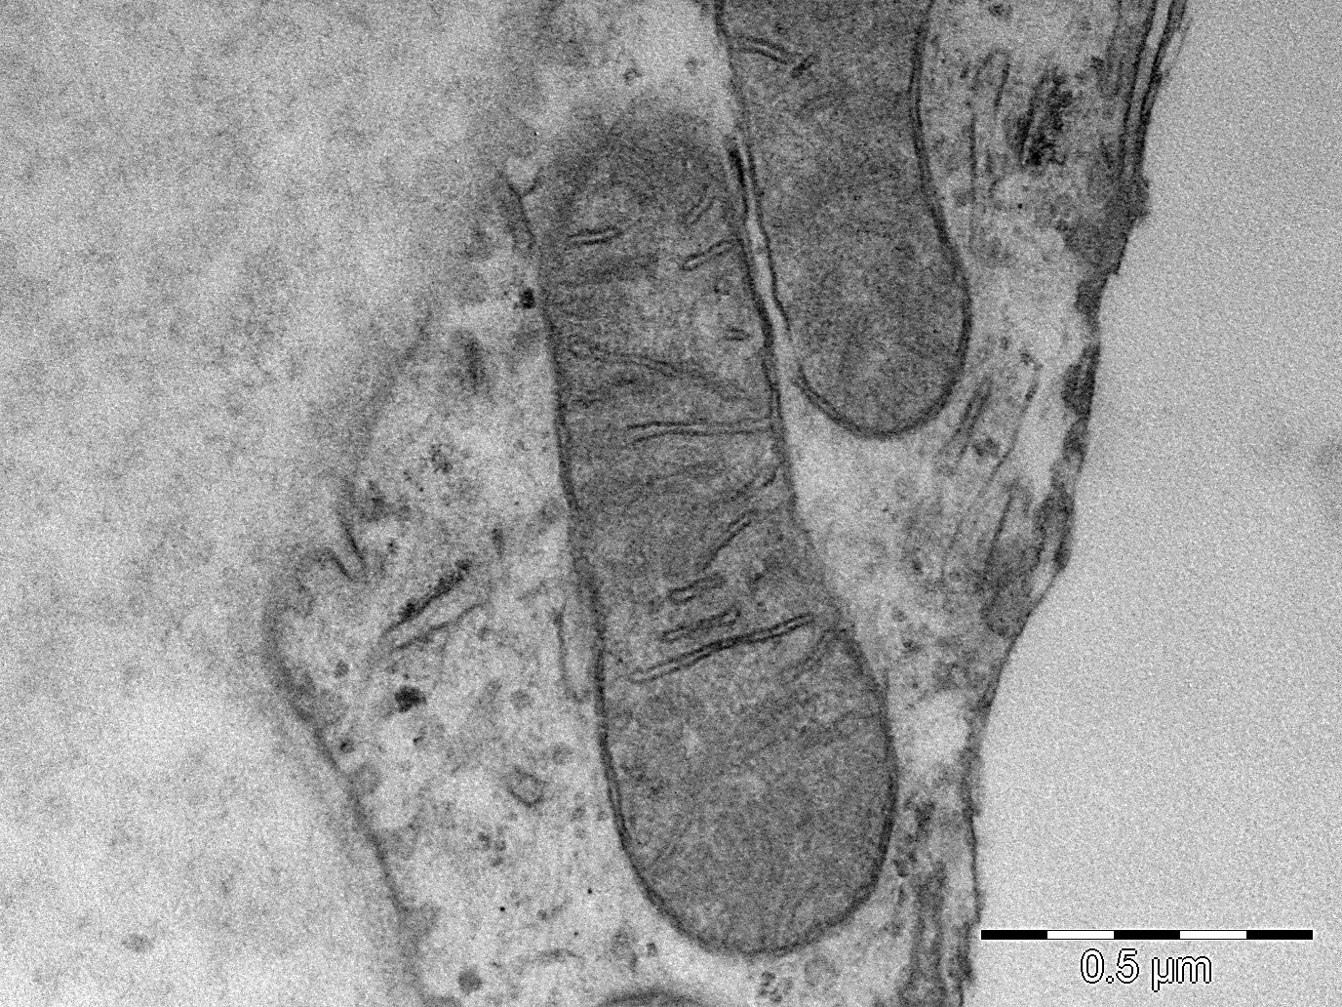
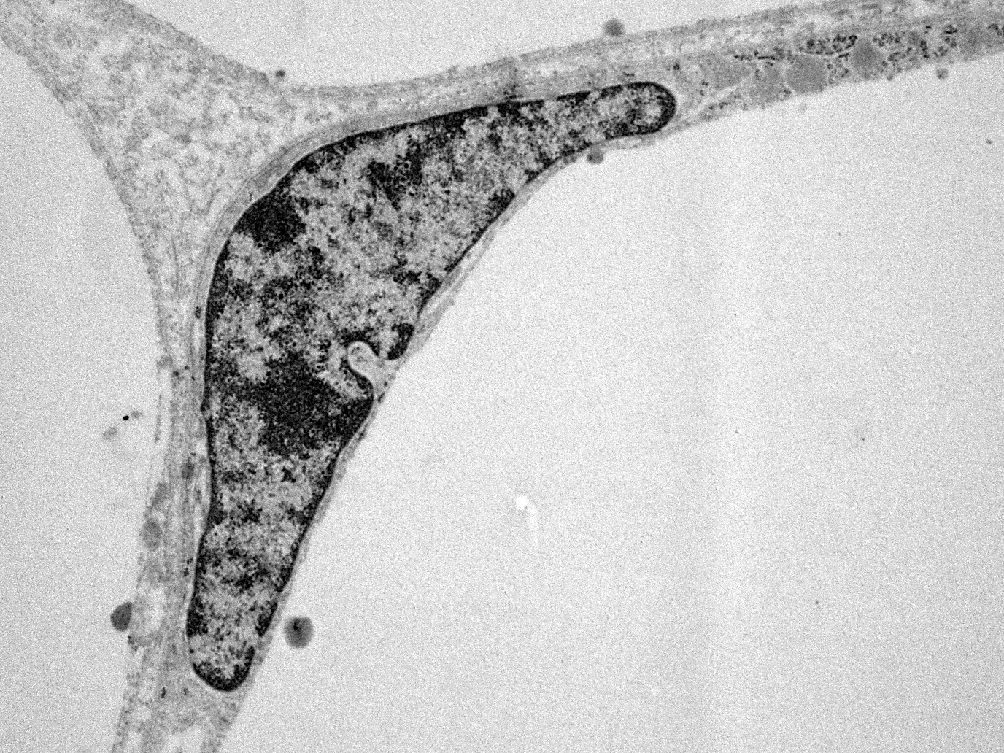
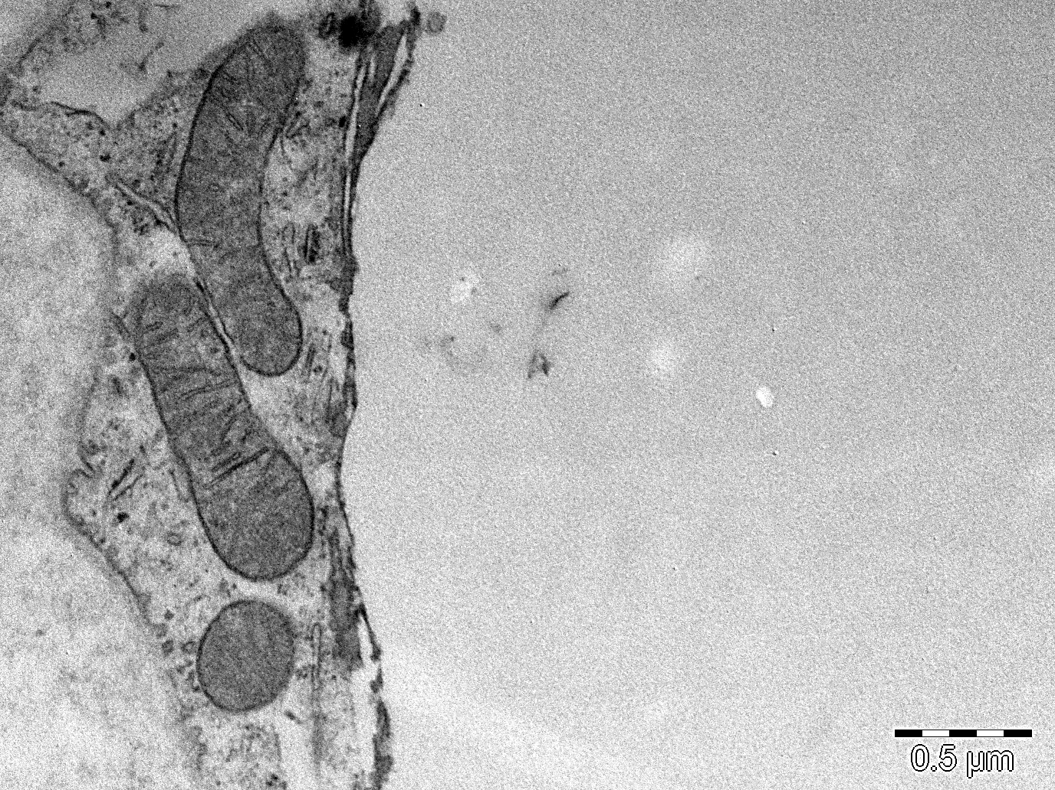
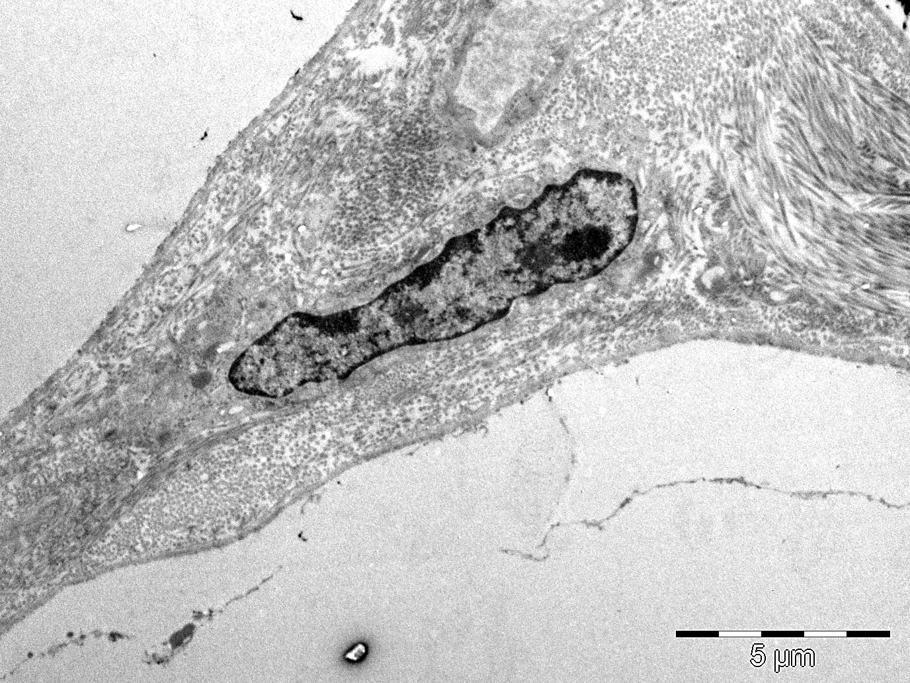
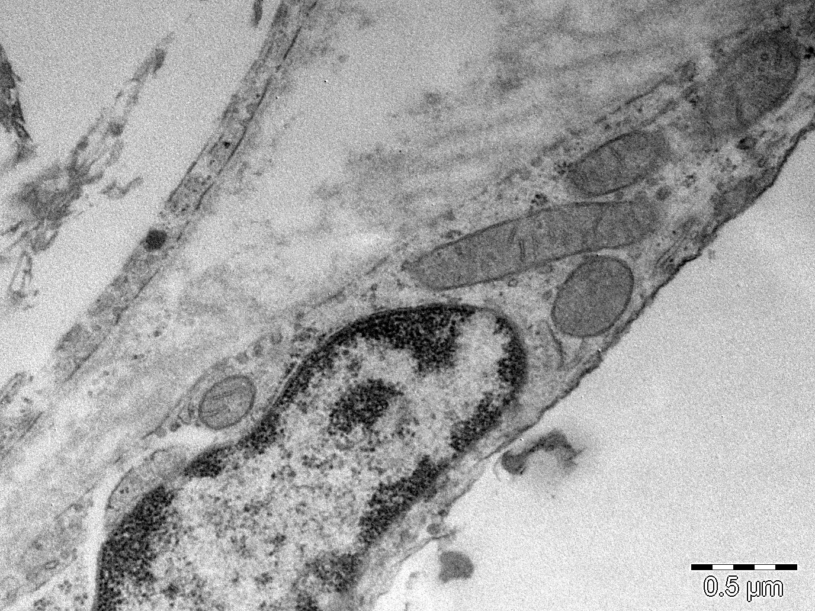
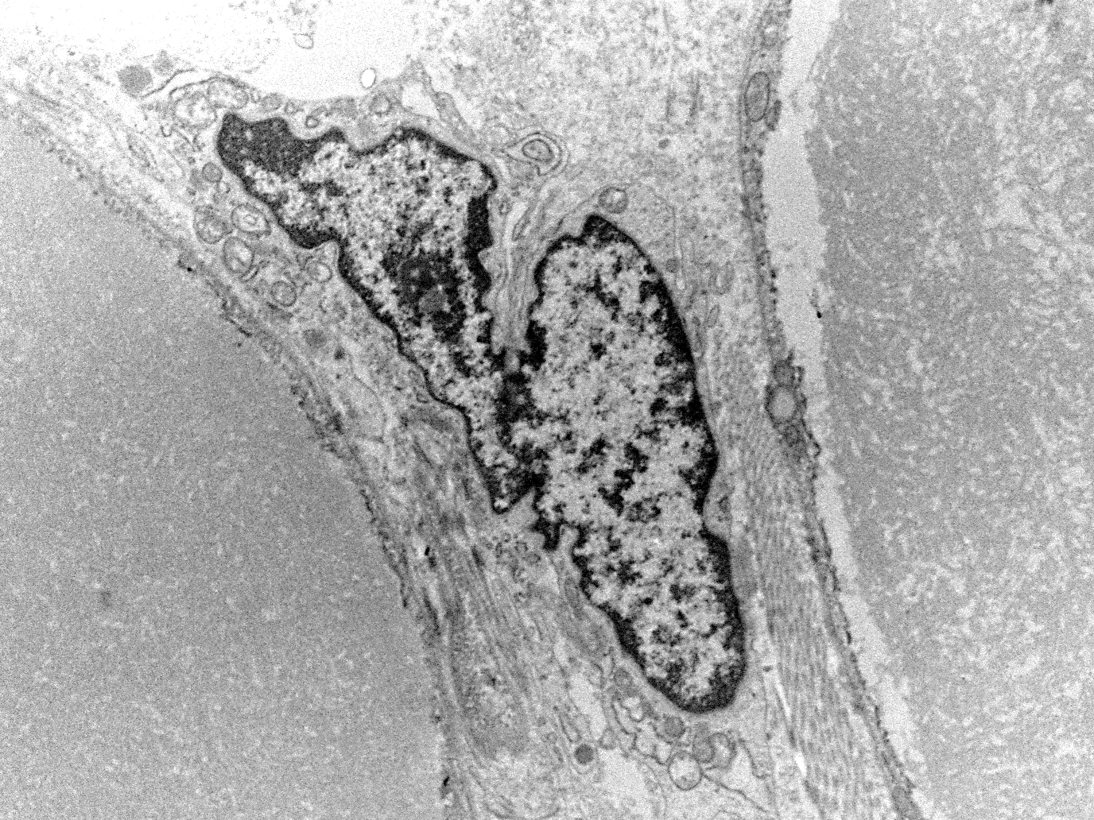
(a)
Euchromatin
Heterochromatin
(d)
(b)
Ultrastructural images
Cells & organelles
Mitochondria
(e)
Mitochondria
Nucleus
Nuclear pore
(c)
(f)
Nuclear pore

Slide 2

(a)
Paul A. Gagniuc. Algorithms in Bioinformatics: Theory and Implementation. John Wiley & Sons, Hoboken, NJ, USA,2021, ISBN: 9781119697961.

Slide 3

(b)
Mitochondria
Paul A. Gagniuc. Algorithms in Bioinformatics: Theory and Implementation. John Wiley & Sons, Hoboken, NJ, USA, 2021, ISBN: 9781119697961.

Slide 4

Mitochondria
Mitochondria
Nucleus
Mitochondria
Nuclear pore
Nuclear pore
(c)
Paul A. Gagniuc. Algorithms in Bioinformatics: Theory and Implementation. John Wiley & Sons, Hoboken, NJ, USA, 2021, ISBN: 9781119697961.

Slide 5
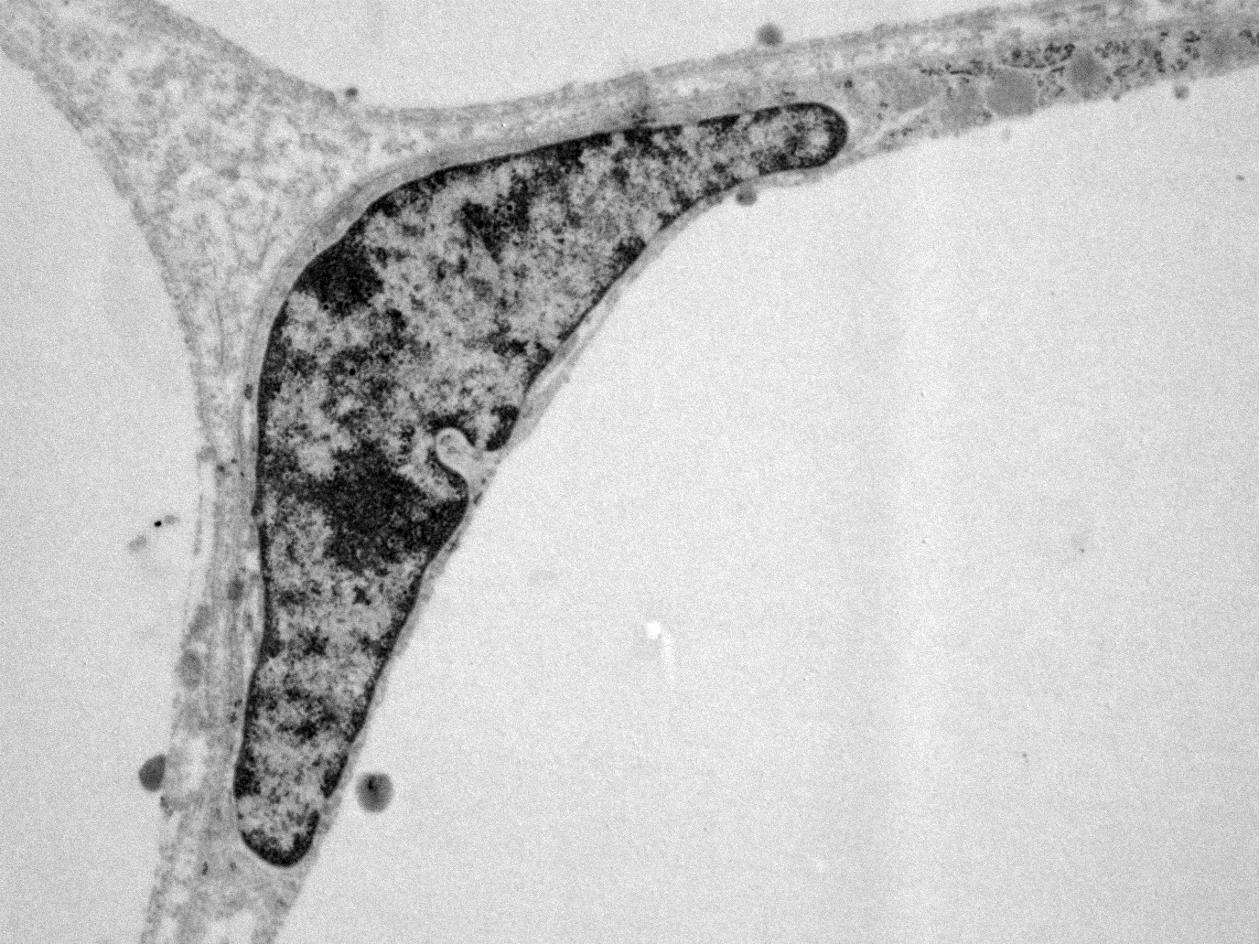
Euchromatin
Heterochromatin
(d)
Paul A. Gagniuc. Algorithms in Bioinformatics: Theory and Implementation. John Wiley & Sons, Hoboken, NJ, USA, 2021, ISBN: 9781119697961.

Slide 6
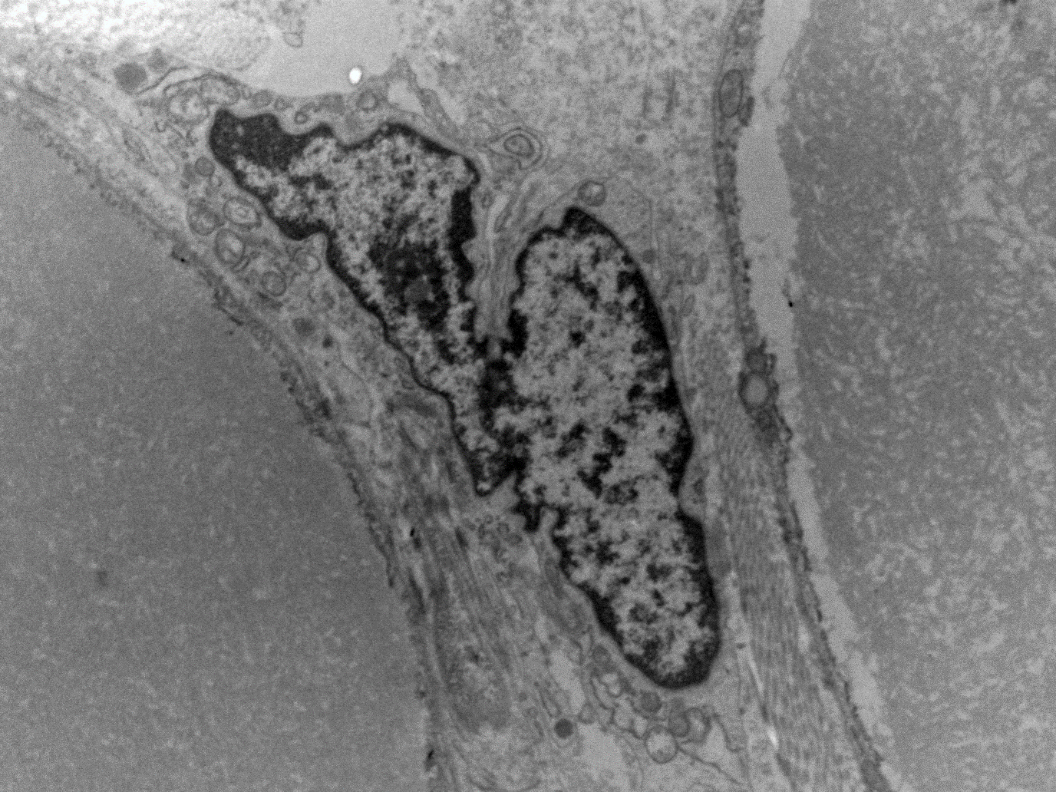
(f)
Paul A. Gagniuc. Algorithms in Bioinformatics: Theory and Implementation. John Wiley & Sons, 2021, Hoboken, NJ, USA, ISBN: 9781119697961.

Slide 7


Ultrastructural images of adipocyte cells from Bos taurus (Cattles)
Ultrastructural images of adipocyte cells from Bos taurus (Cattles). Adipocytes especially show how tolerant and adaptable cellular organelles are to various constant mechanical stresses. (a,b) Shows mitochondria in adipocytes. The right side of homogeneous light gray content represents the lipid droplet. (c) Shows a few mitochondria in proximity to the cell nucleus. (d,e) Shows the shape of the cell nucleus in different mechanical constraints induced by the size of the lipid droplets. Again, the homogeneous light gray content represents the lipid droplets from the surrounding cells. (f) Shows two adipocytes with adjacent nuclei. Within each nucleus (c-f), the genetic material can be observed in different states of activity. Inside each nucleus, the dark gray (to almost black) areas represent heterochromatin and the normal gray areas represent euchromatin. In short, euchromatin contains a specific and dynamic set of active genes that is expressed only in adipocytes, while areas of heterochromatin contain the remaining unexpressed genes. At the edge of the nuclear membrane, nuclear pores can be observed. Interruptions with a light gray hue can be seen along the perimeter of the nuclear membrane. Those are the nuclear pores. Note that each image shows only a small fraction of the actual size of an adipocyte (a-f, courtesy Dr. Elvira Gagniuc, Department of Pathology, Faculty of Veterinary Medicine, University of Agronomic Sciences and Veterinary Medicine, Bucharest).
Cite this work as:
Paul A. Gagniuc. Algorithms in Bioinformatics: Theory and Implementation. John Wiley & Sons, Hoboken, NJ, USA, 2021, ISBN: 9781119697961.

